Slide 1
OCT Calibration Procedure

Slide 2
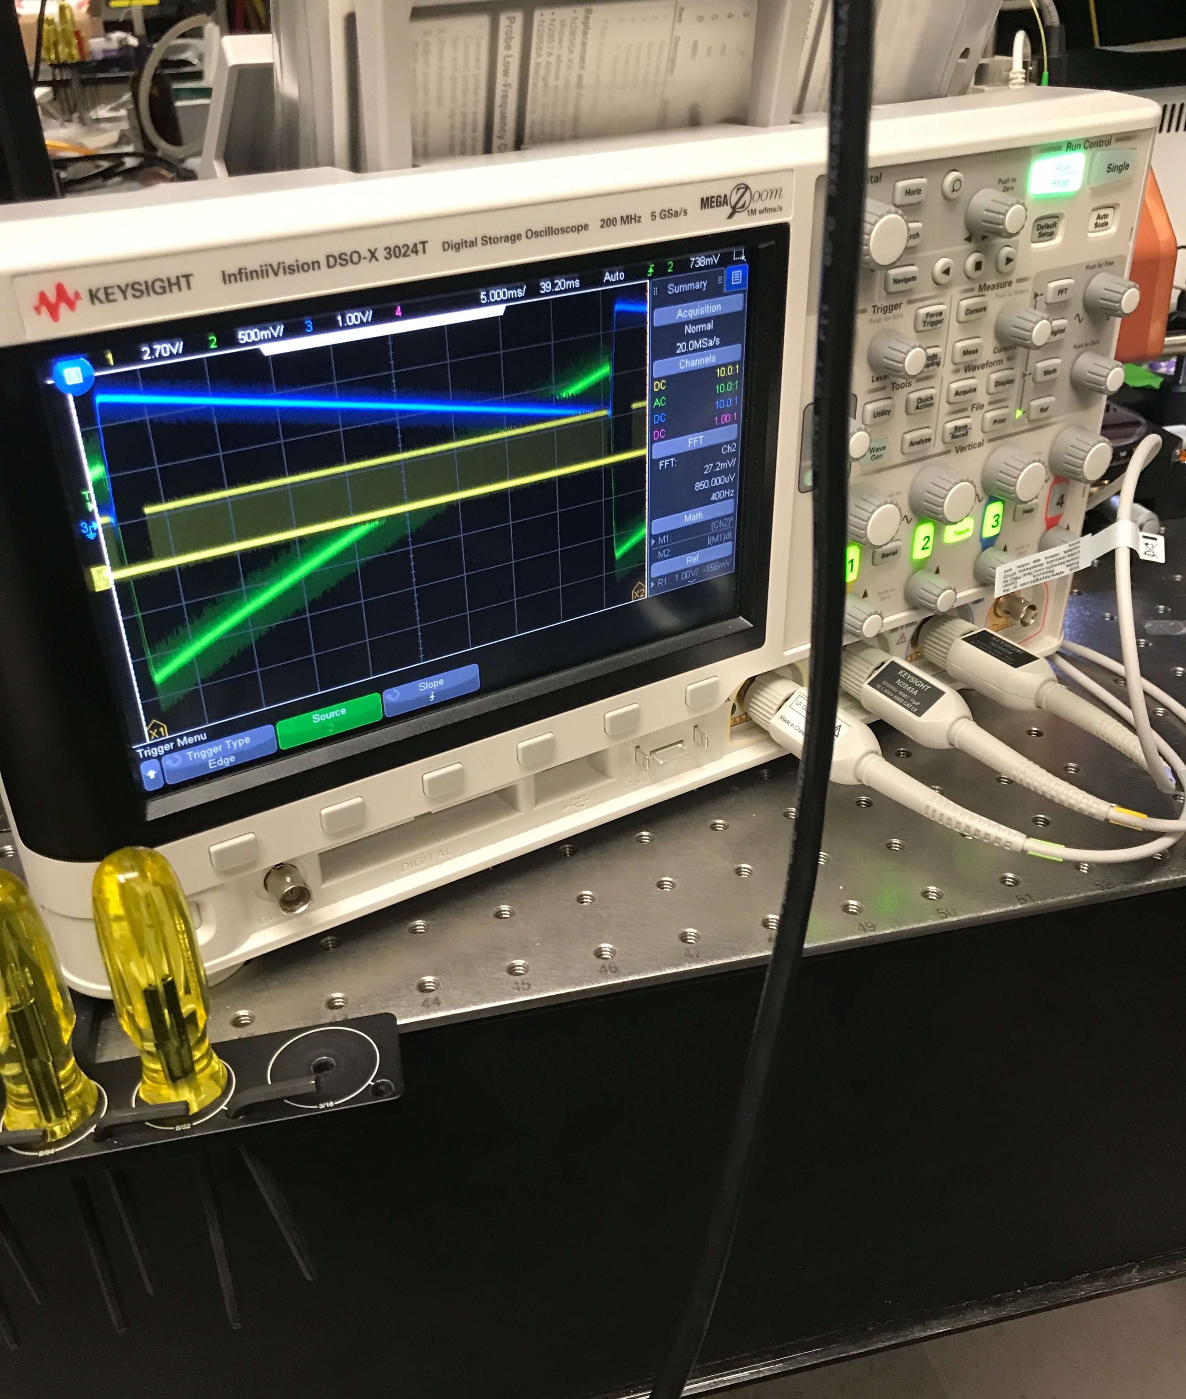
Prep Work
The goal of this calibration procedure is to both create a conversion between Manufacturer Coordinates and to account for distortion along the fast axis
It may be a good idea to probe the trigger lines and driving waveform outputs on the MCU for the device to verify that for standard settings it is operating as expected.
Potential issues:
Stabilization offset / return time offset for triggering, lack thereof could result in acceleration distortion
Triggering inappropriately, the Wasatch system triggers on the return path for standard trigger delay settings

Slide 3
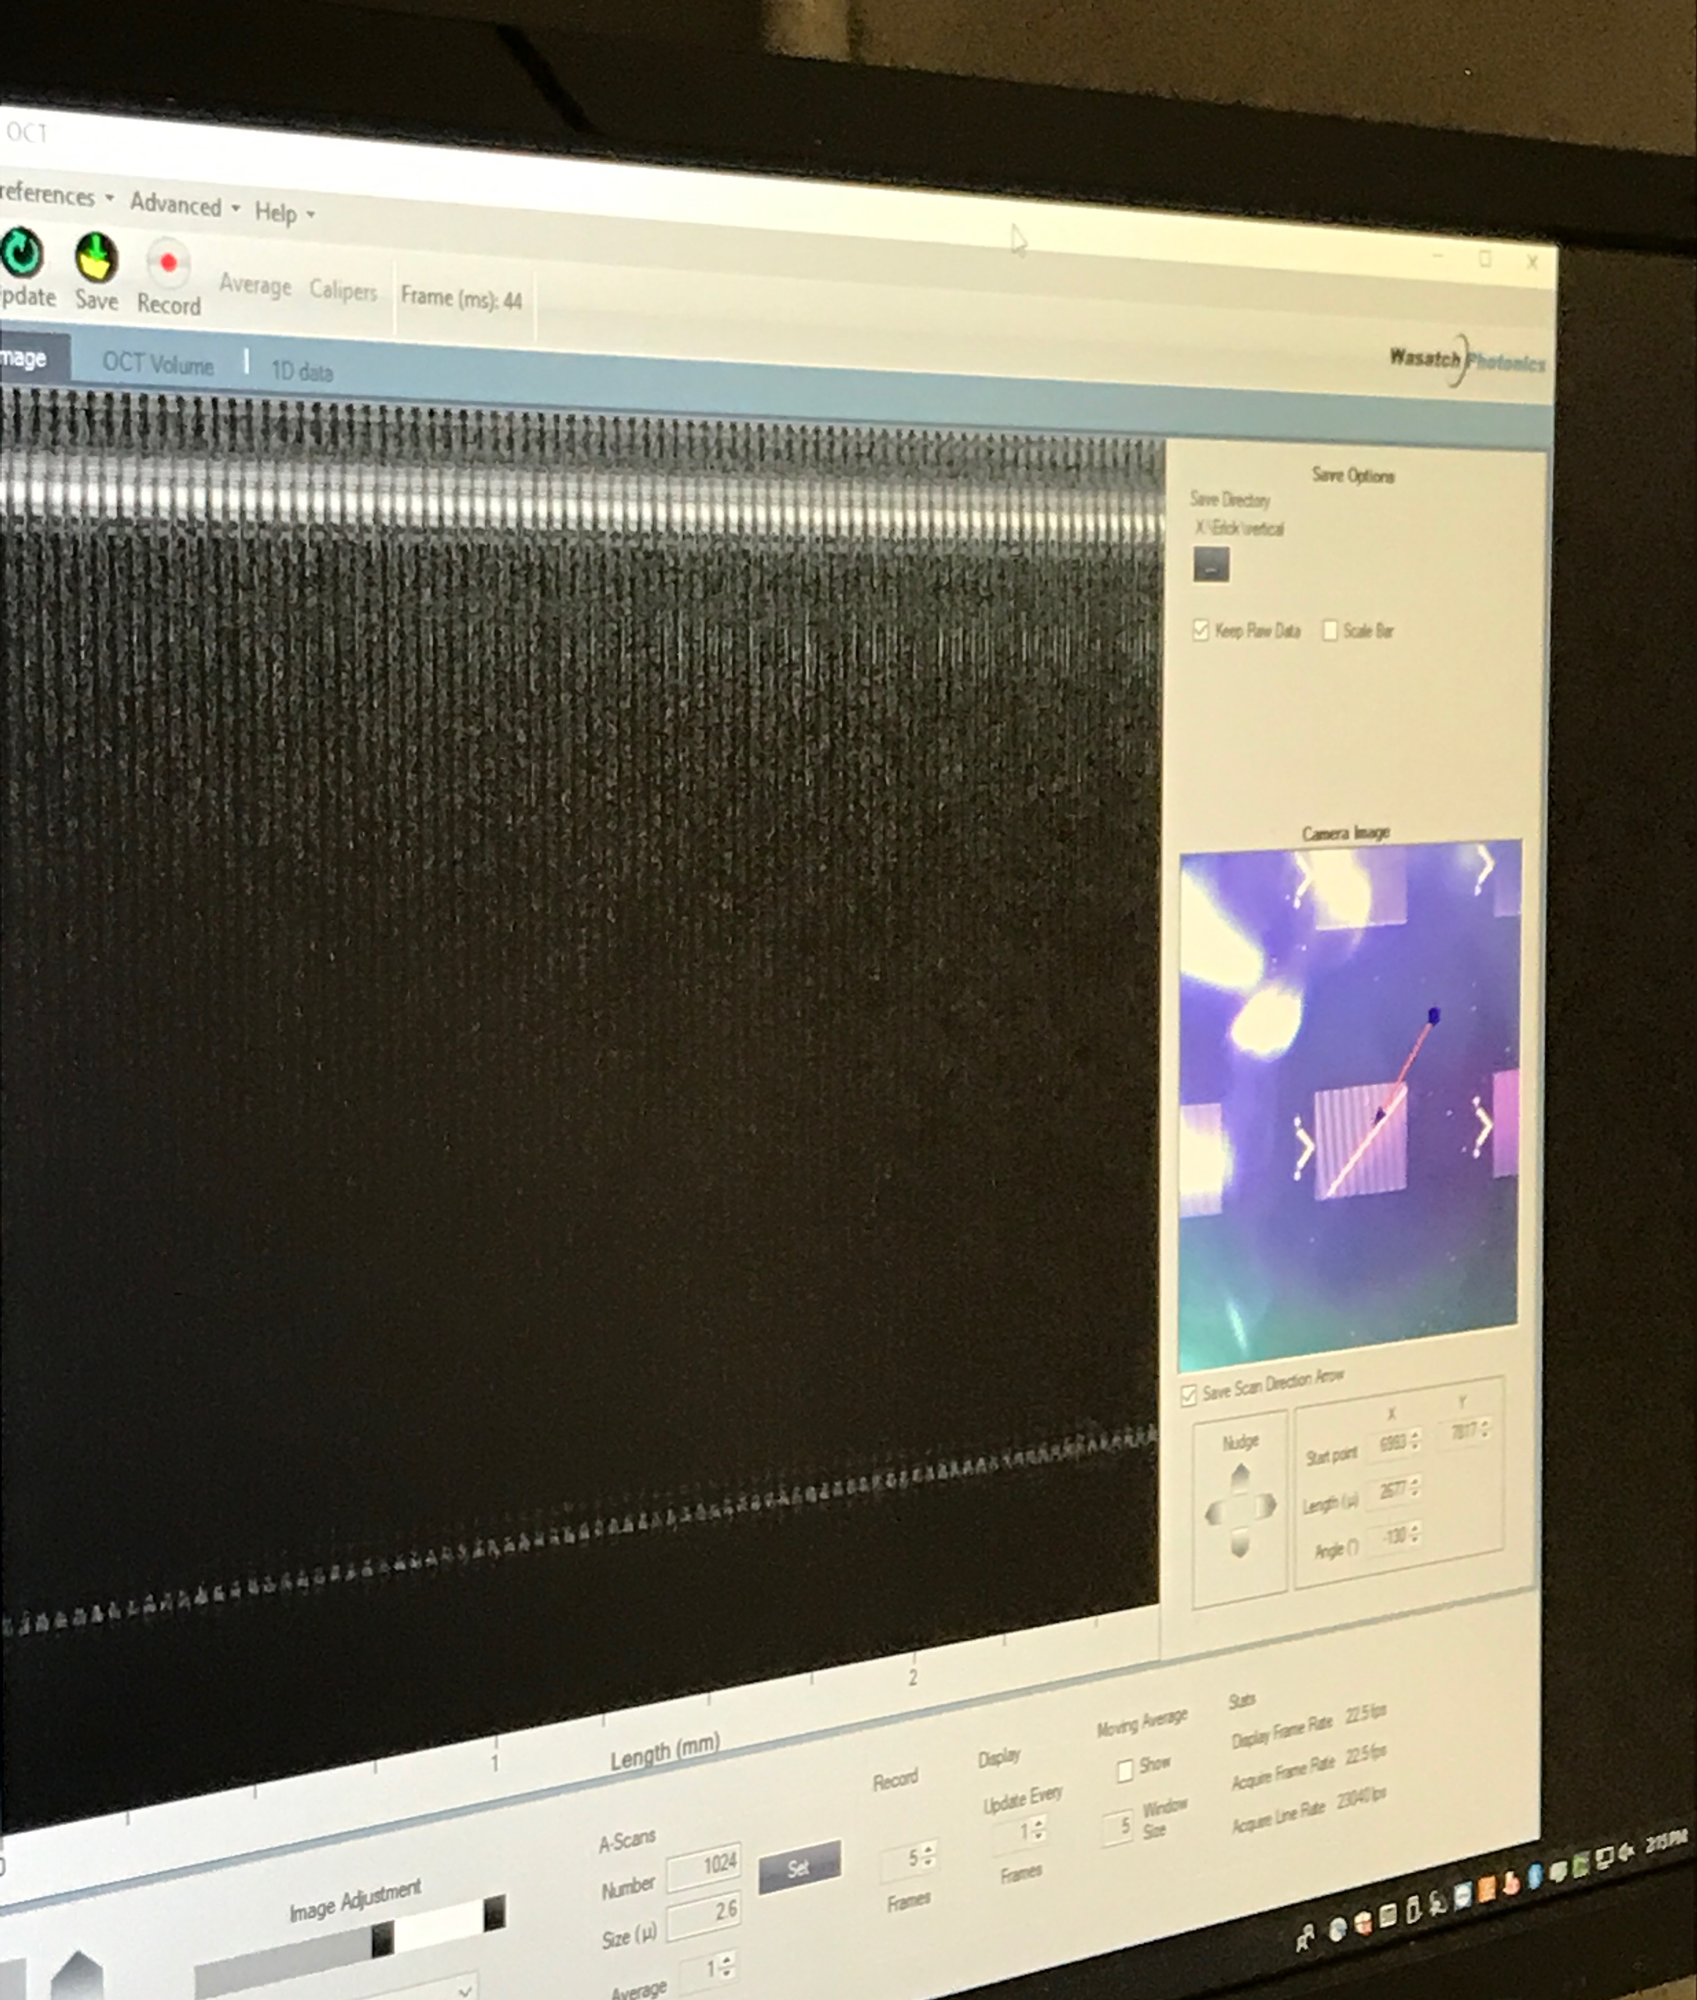
Initial Placement
Find a silicon calibration target that has visible landmarks and well known spacing.
Initialize your OCT acquisition and control software of choice,
Make sure that you are able to enter scanning coordinates directly, rather than through a GUI
Decide what side length you want to use, this area should be entirely contained in the grid in both directions.
Set and verify any settings for offsets, trigger delays, etc. from earlier debugging.

Slide 4
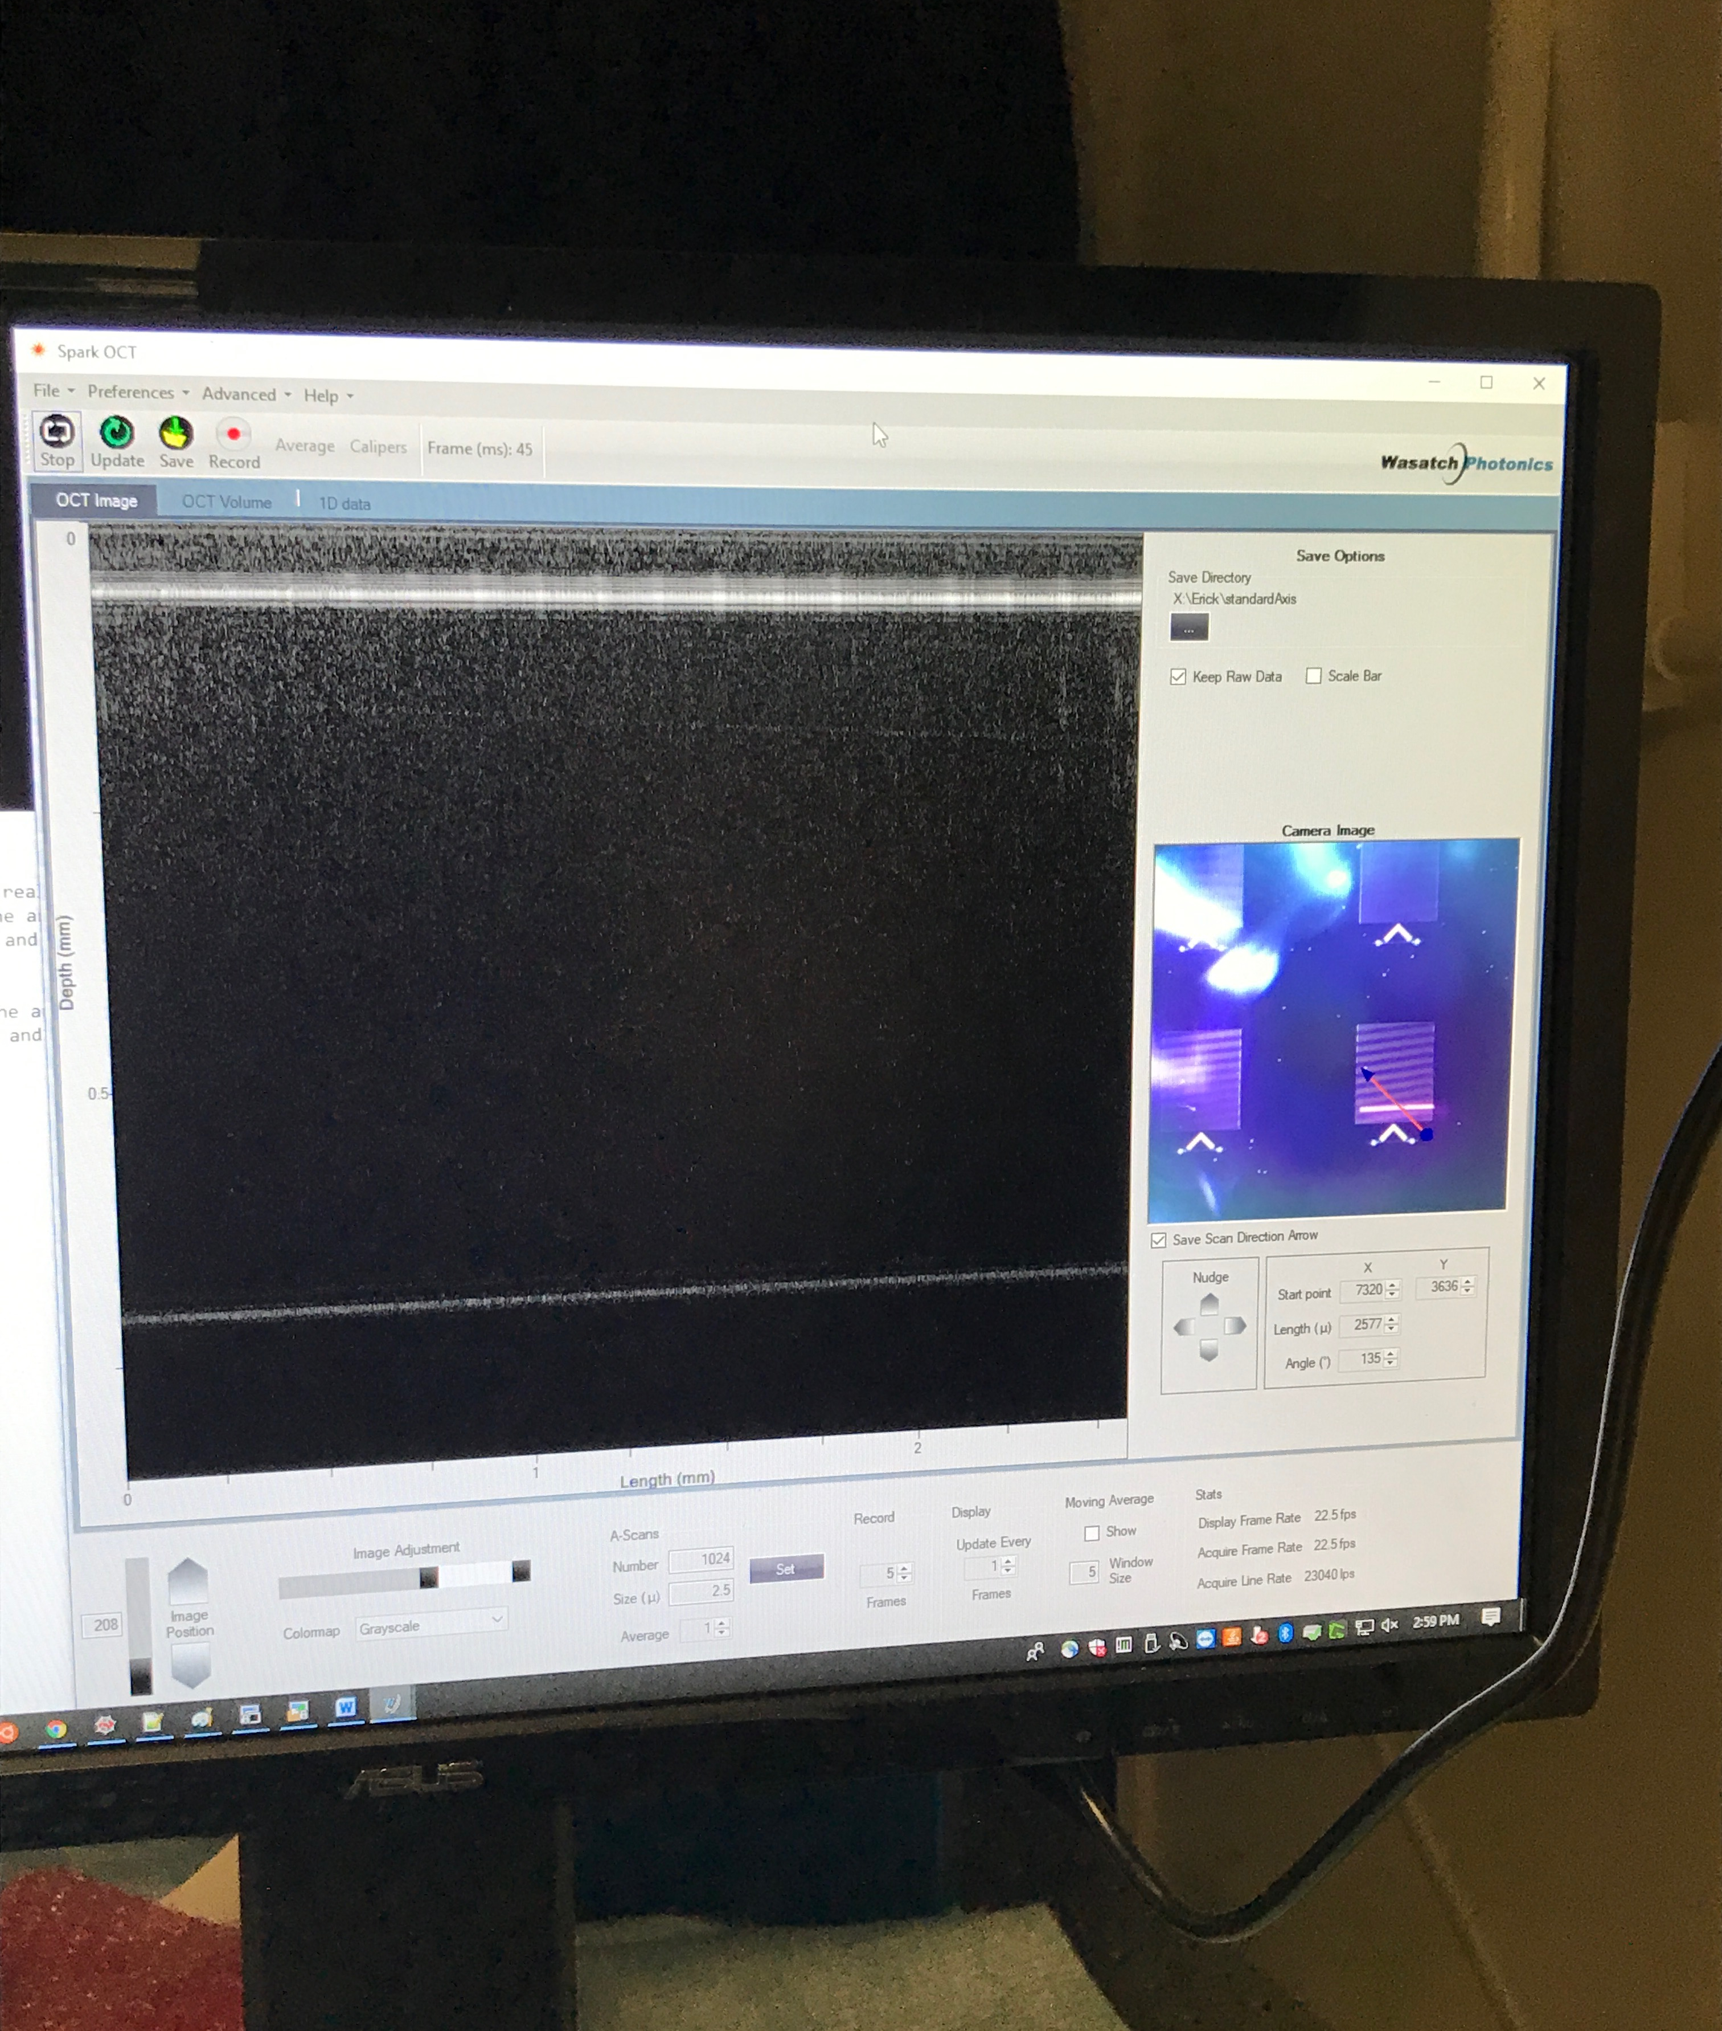
Standard Alignment
Set a two-dimensional real time scan to the axis parallel to the slow axis of the standard 3d volume according to your chosen side length
Make sure that the scanning area is entirely contained in the grid
Adjust the target until your line is parallel to the lines in the grid target. When aligned, the window will appear to be of uniform brightness as you scan on top of one line.

Slide 5
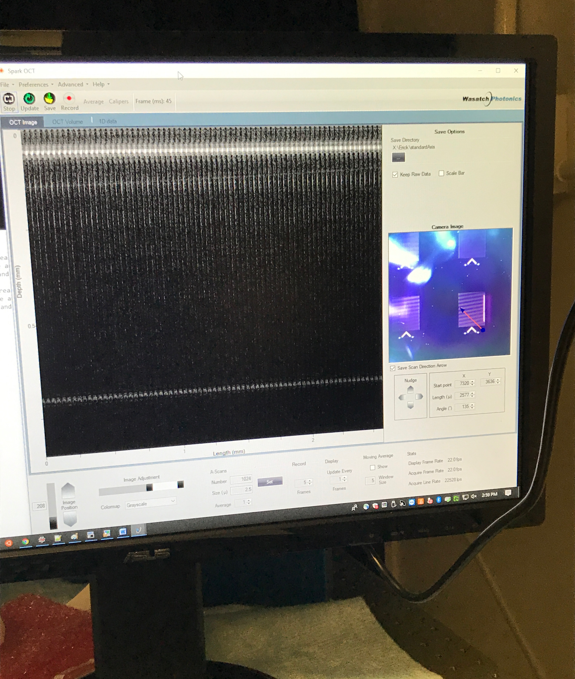
Standard Fast Axis
Using the terminal or other direct coordinate setting method, flip the scan line 90 degrees.
Note the direction of movement of the scan line, in this case the laser progresses away from the arrow at the bottom of the grid
Make sure that the scanning area is entirely contained in the grid
Save your fast scan

Slide 6
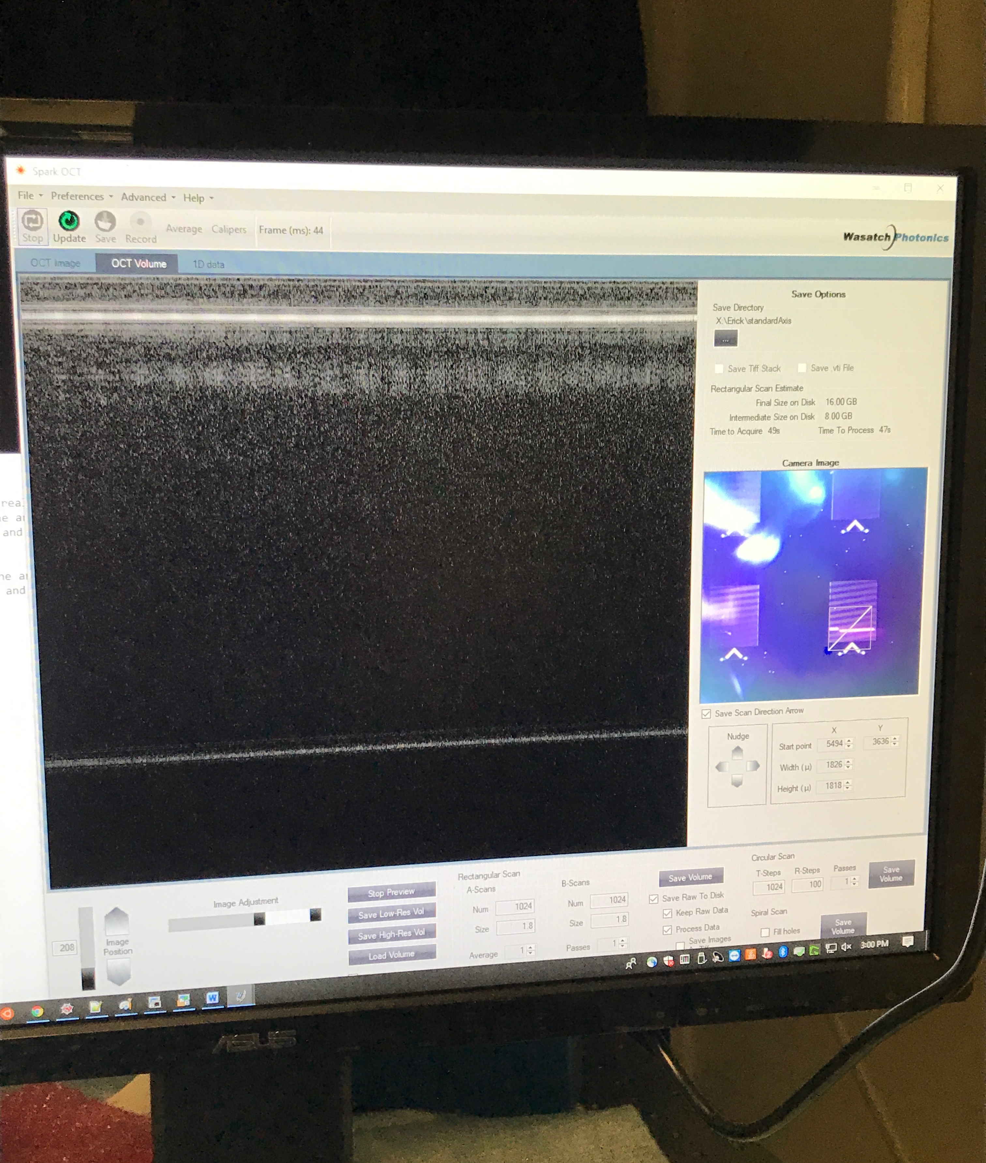
Standard Slow Axis
Using the terminal or other direct coordinate setting method, set a 3d scan where the fast axis is parallel to the lines in the grid and whose side lengths (not diagonal) are equal to the pre-determined lengths of the fast axis line.
Note the direction of movement of the scan line, the slow axis should propagate in the same direction as the fast axis laser from before.
The volume should be entirely contained on the grid, if not go back to step 1.
Save your volume, make sure not to touch the table.

Slide 7
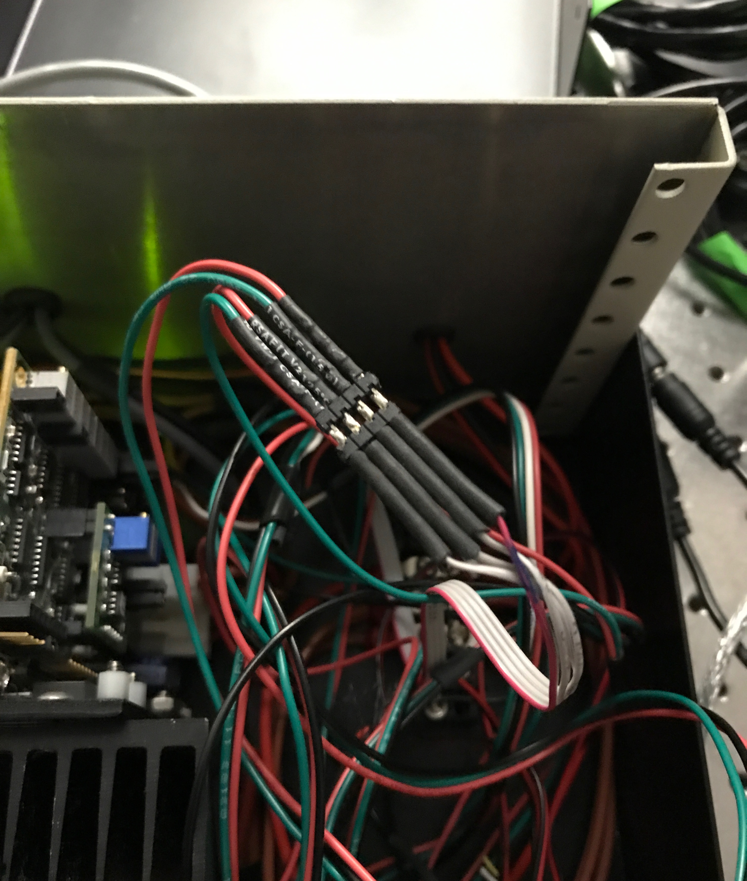
Flipping the Axis
The goal here is to reverse the roles of the X and Y galvos
Some systems allow you to set the orientation of the 3d volume scan, this is the preferred method.
For some systems you have to manually switch a pair of signal wires in the driver box. Make sure to turn off the galvos first to avoid damage
For the Wasatch, switch the two green wires, and then switch the two red wires
Y
X
X
Y
Y
X

Slide 8
Flipped Scanning
Flip the silicon target 90 degrees. Bear in mind that your system coordinate system will now also be rotated 90 degrees.
Preform the same alignment and scanning task as before, make sure that the progression of the laser along the fast axis is the same relative to your landmark as previous. Also make sure that your slow scanning axis in your 3d volume progresses the same way

Slide 9
Data Analysis

